Slide 1
FULLY REUSED VLSI ARCHITECTURE OF FM0/MANCHESTER ENCODING USING SOLS TECHNIQUE FOR DSRC APPLICATIONS
N. Preethi 2451-17-735-025
BVS. Mohan Krishna 2451-17-735-030
B. Prashansa Evangeline 2451-17-735-055
Guide:
DR.DRVA SHARAT KUMAR
Associate Professor

Slide 2
Objective of the project
To combine the VLSI architecture of FM0 and Manchester encoding so that it reduces the power used by reducing the number of components used and improves the performance of FM0 and Manchester encoding using Similarity Oriented Logic Simplification (SOLS) technique
The dedicated short-range communication (DSRC) standards generally adopt FM0 and Manchester codes to reach dc-balance, enhancing the signal reliability

Slide 3
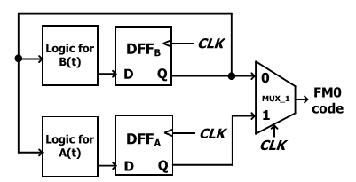
Fm0 Encoding
The coding principle of FM0 is listed as the following three rules.
1) If X is the logic-0, the FM0 code must exhibit a transition between A and B.
2) If X is the logic-1, no transition is allowed between A and B.
3) The transition is allocated among each FM0 code no matter what the X is.
A(t) = B(t − 1)’
B(t) = X ⊕ B(t − 1)
With both A(t) and B(t), the Boolean function of FM0 code is denoted as
CLK A(t) + CLK B(t)

Slide 4
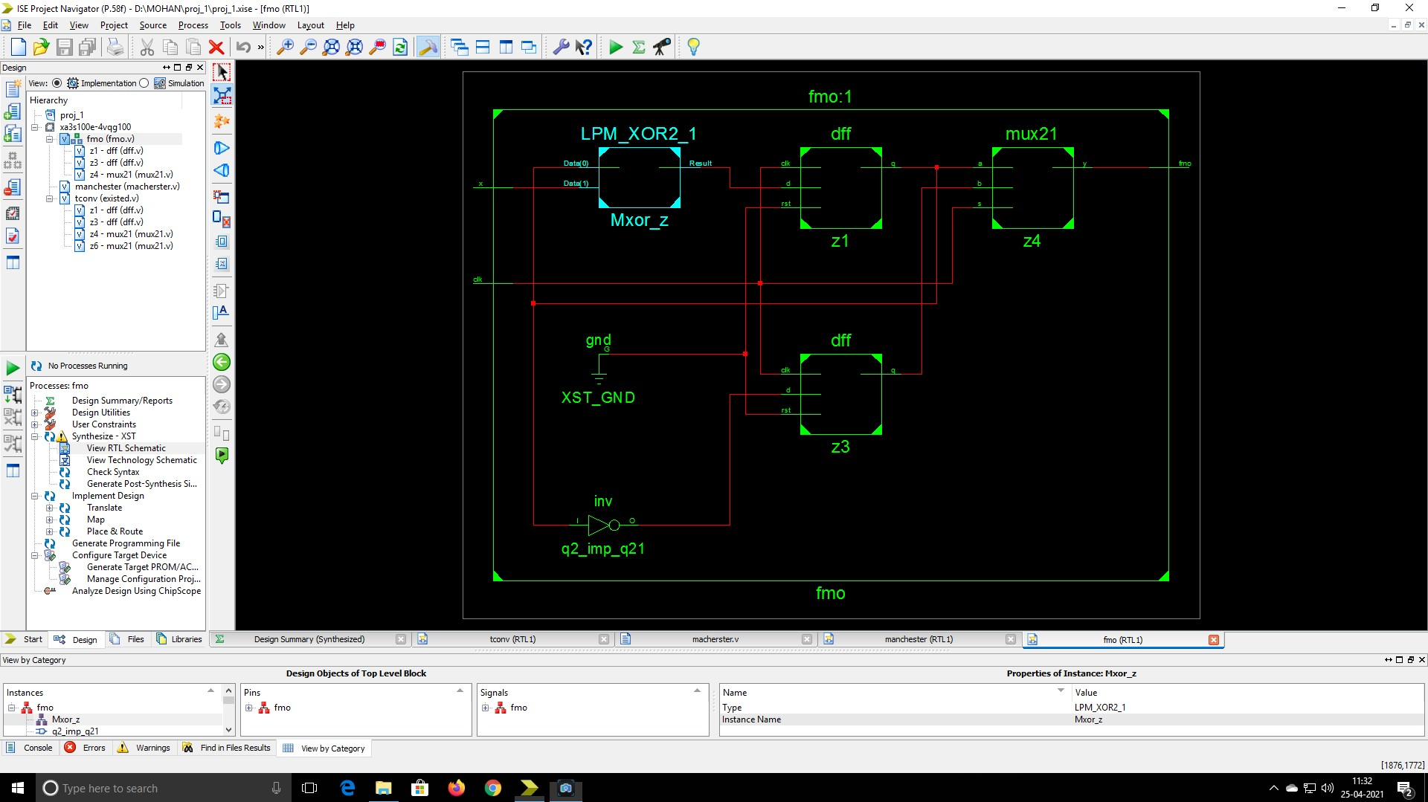
rtl schematic of Fm0 encoding

Slide 5
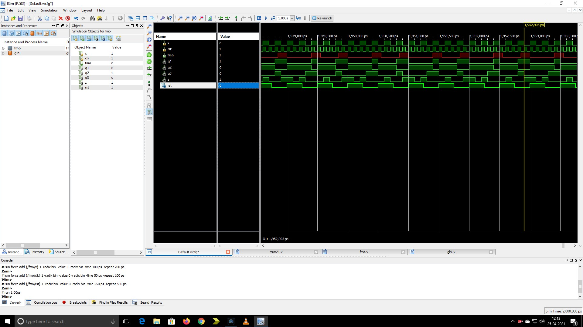
behavioural simulation of fm0 encoding

Slide 6
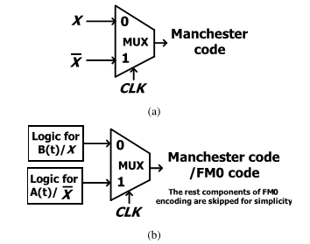
Manchester encoding
Manchester coding (also known as phase encoding, or PE) .
It is a line code in which the encoding of each data bit has at least one transition and occupies the same time.
Manchester provides an average DC level of 50%.
The Manchester code is derived from
X ⊕ CLK = X CLK’ + X’ CLK

Slide 7
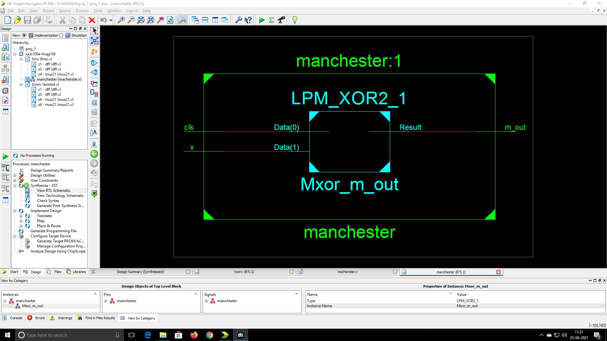
rtl schematic of manchester encoding

Slide 8
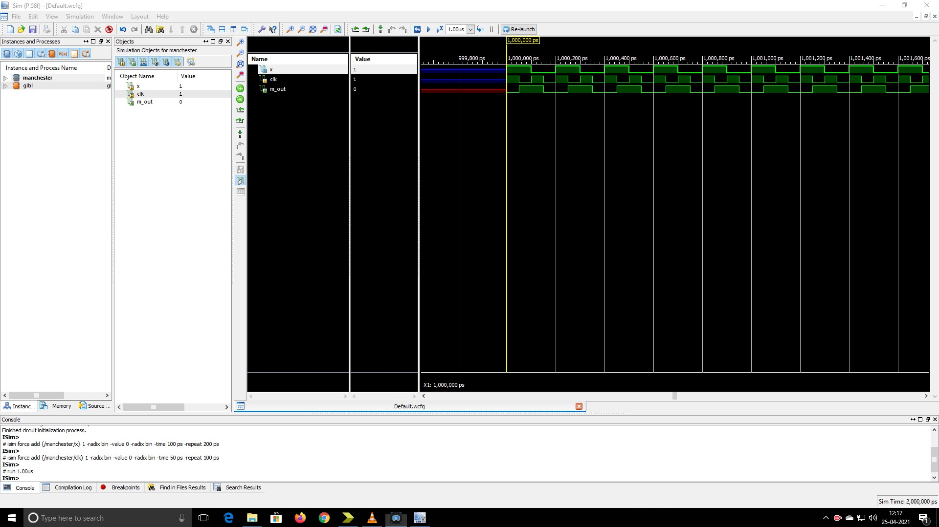
behavioural simulation og manchester encoding

Slide 9
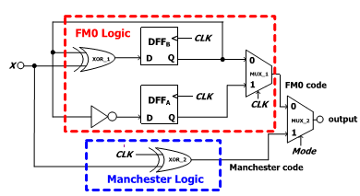
EXISTING SYSTEM
DFFA and DFFB store the state code of the FM0 code
The determination of which coding is adopted depends on the Mode selection of the MUX−2
FM0 code: mode=0
Manchester code: mode=1

Slide 10
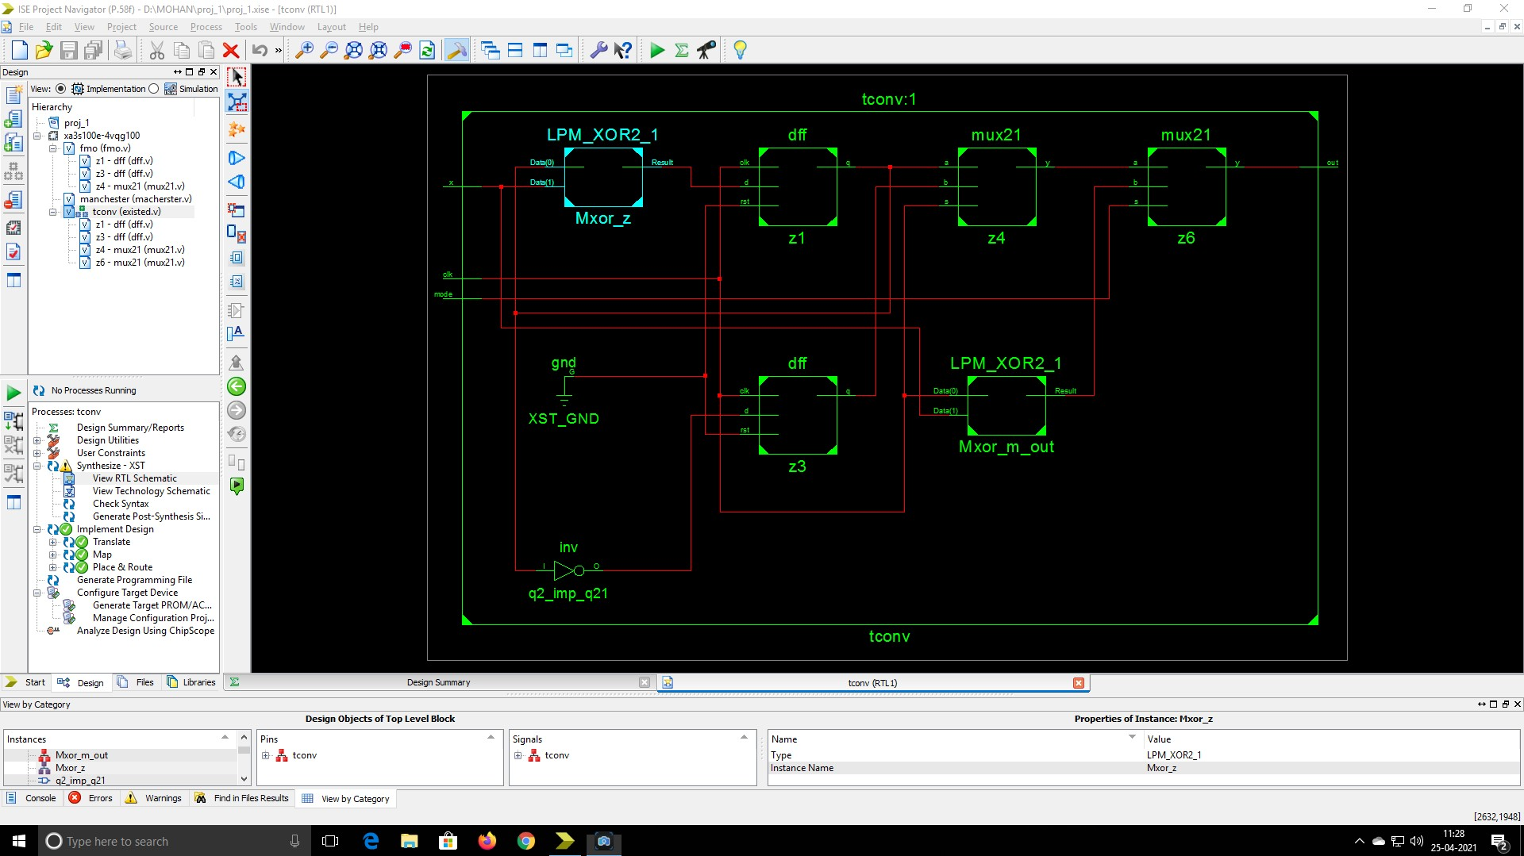
rtl schematic of Existing System

Slide 11
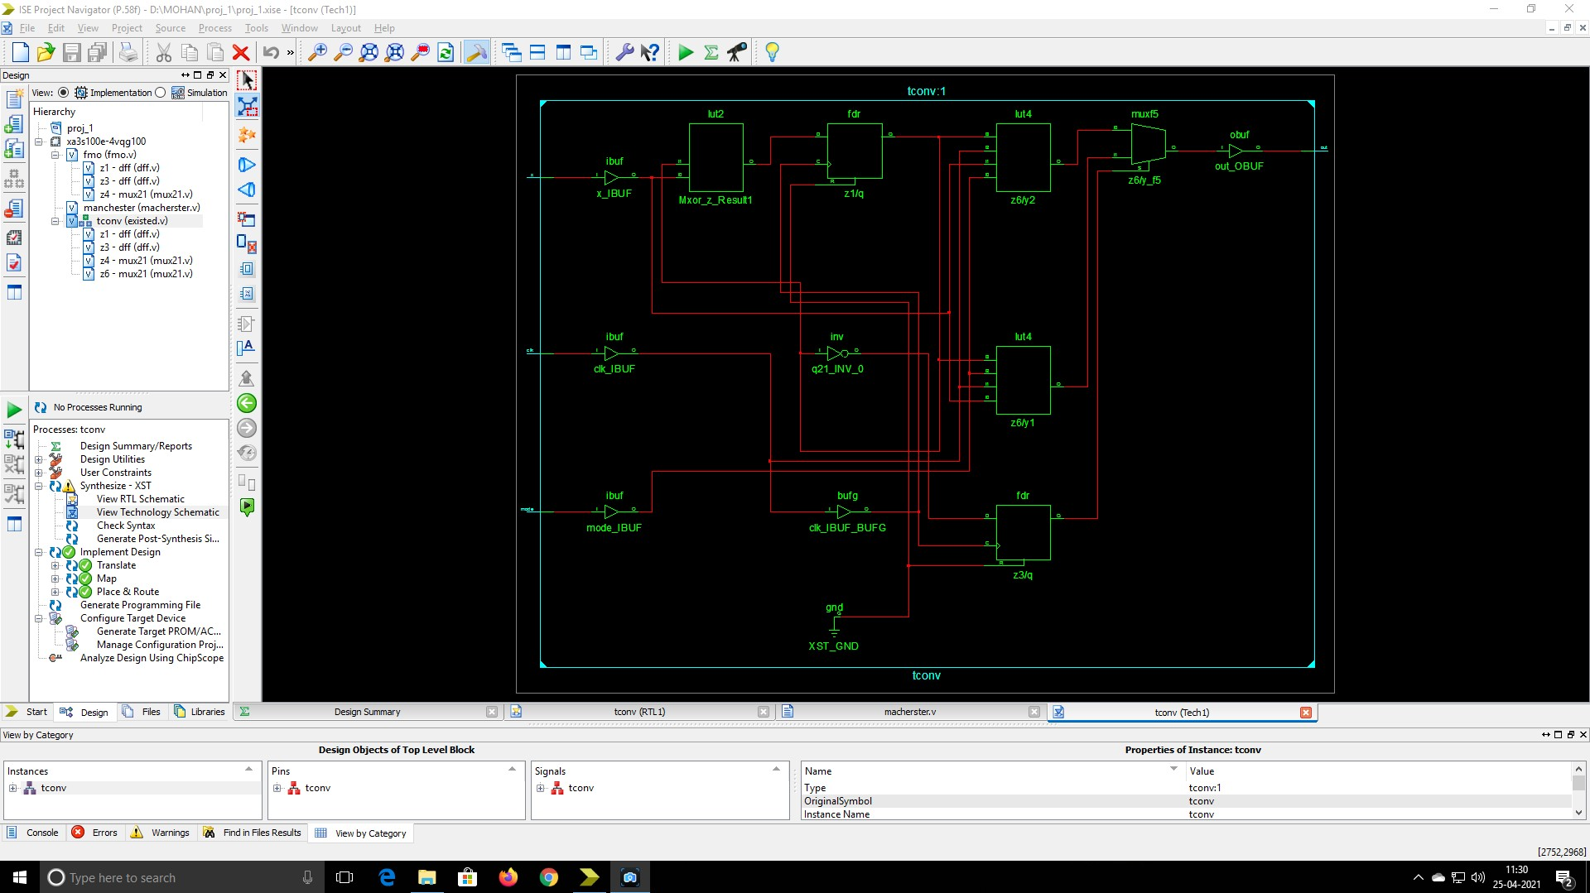
technology schematic of existing model

Slide 12
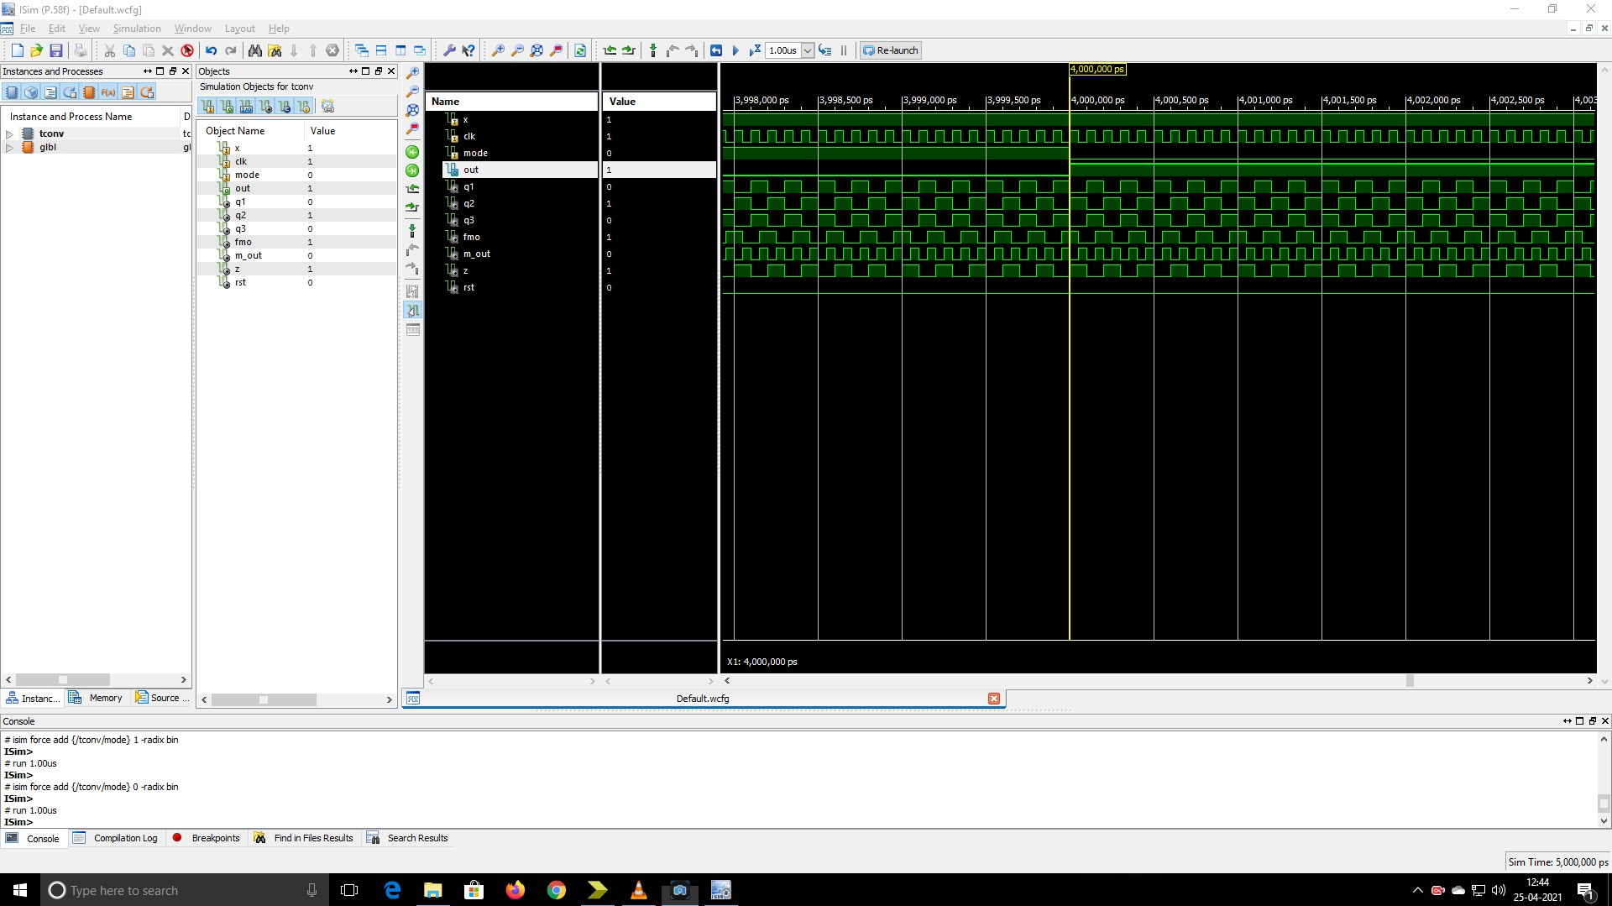
behavioural simulation of existing model

Slide 13
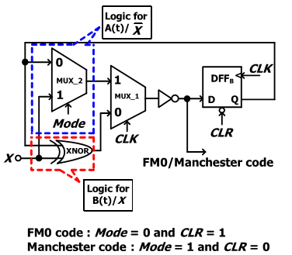
PROPOSED SYSTEM
Similarity Oriented Logic Simplification (SOLS) technique
Area-Compact Retiming
Balance Logic-Operation Sharing
Merges architecture together and synchronize the operation

Slide 14
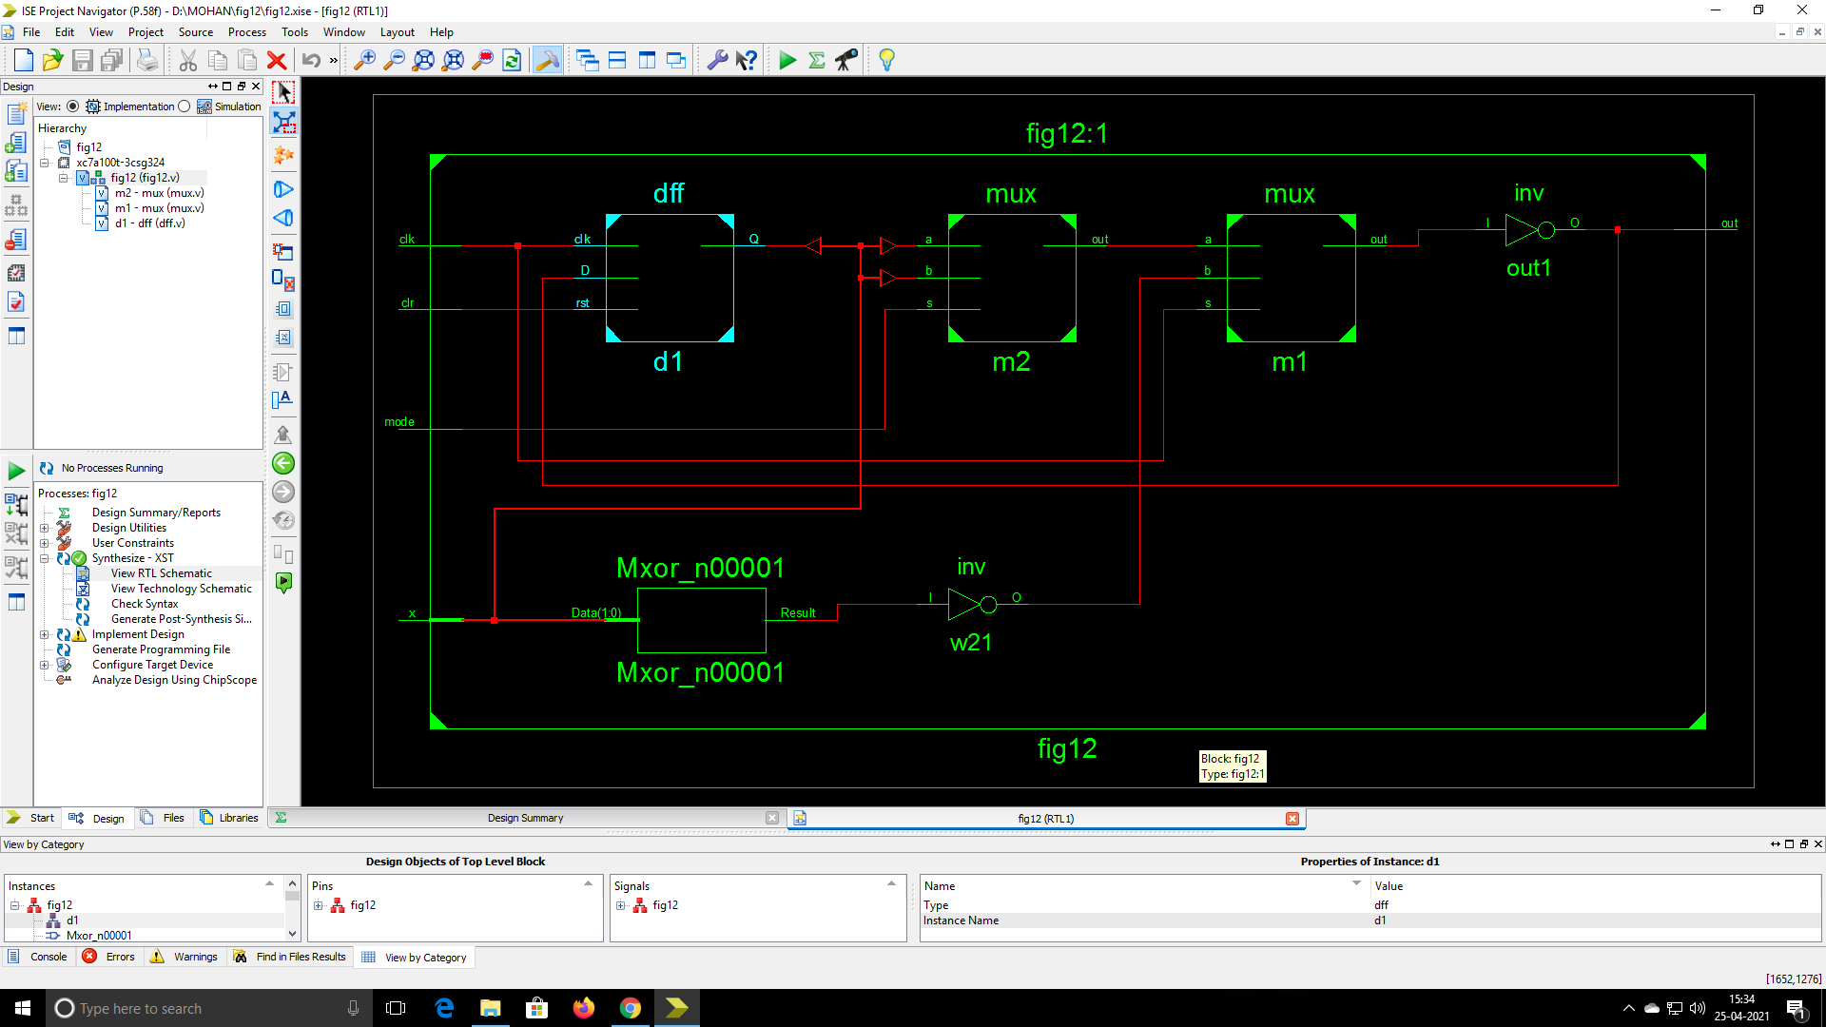
rtl schematic of proposed system

Slide 15
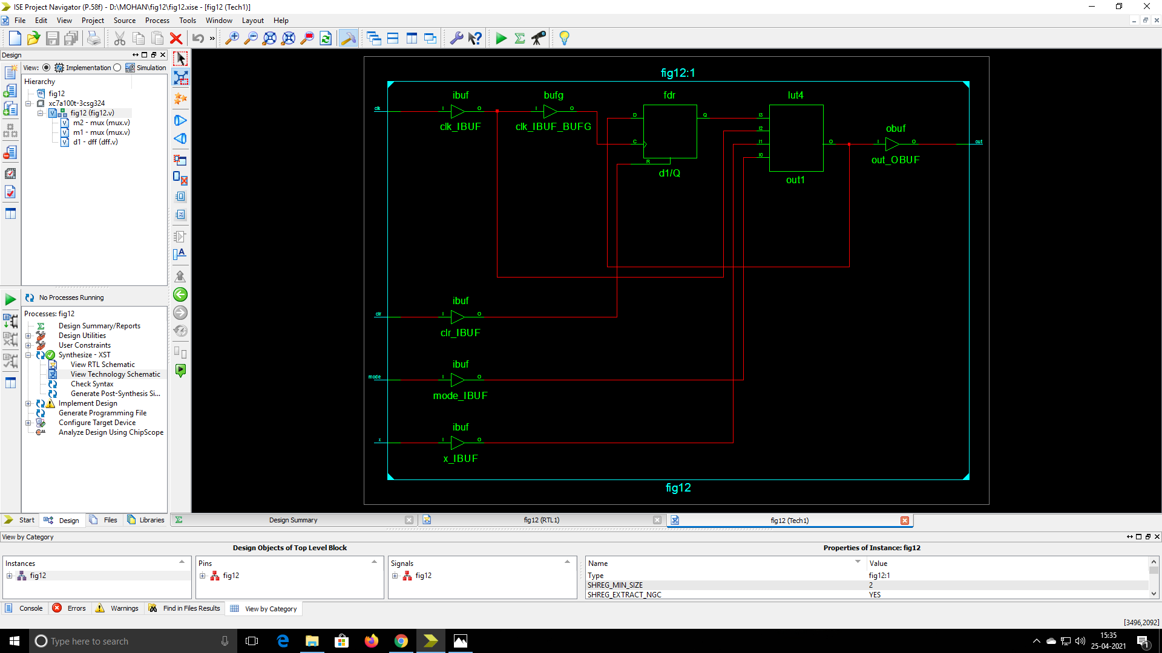
technology schematic of proposed model

Slide 16
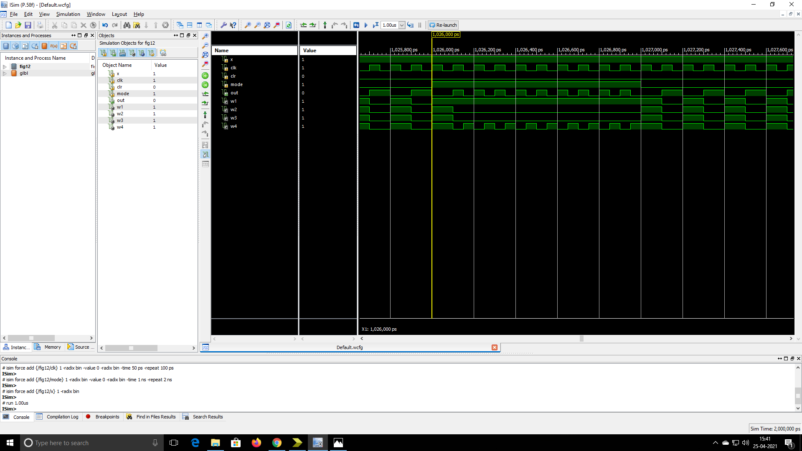
behavioural simulation of proposed model

Slide 17
Utilization Comparison
 | Existed | Proposed
Number of Slices: | 2 out of 960 0% | 1 out of 960 0%
Number of Slice Flip Flops: | 2 out of 1920 0% | 1 out of 1920 0%
Number of 4 input LUTs: | 3 out of 1920 0% | 1 out of 1920 0%
Number of IOs: | 3 | 5
Number of bonded IOBs: | 3 out of 66 4% | 5 out of 66 7%
Number of GCLKs: | 1 out of 24 4% | 1 out of 24 4%

Slide 18
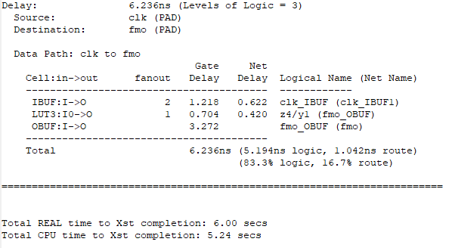
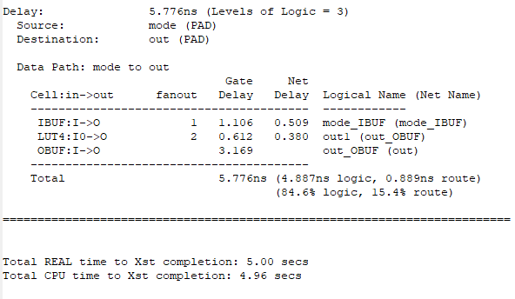
Timing constraint comparisons
Existing model
Proposed Model

Slide 19
REFERENCES
Yu-Hsuan Lee and Cheng-Wei-Pan ”Fully reused VLSI architecture of FM0/Manchester encoding using sols technique for DSRC applications” in IEEE transactions on Very Large Scale Integration (VLSI) systems VOL 23, No.1, January 2015
F. Ahmed-Zaid, F. Bai, S. Bai, C. Basnayake, B. Bellur, S. Brovold, et al., “Vehicle safety communications—Applications (VSC-A) final report,” U.S. Dept. Trans., Nat. Highway Traffic Safety Admin., Washington, DC, USA, Rep. DOT HS 810 591, Sep. 2011
J. B. Kenney, “Dedicated short-range communications (DSRC) standards in the United States,” Proc. IEEE, vol. 99, no. 7, pp. 1162–1182, Jul. 2011
J. Daniel, V. Taliwal, A. Meier, W. Holfelder, and R. Herrtwich, “Design of 5.9 GHz DSRC-based vehicular safety communication ,”IEEE Wireless Commun. Mag., vol. 13, no. 5, pp. 36–43, Oct. 2006
] P. Benabes, A. Gauthier, and J. Oksman, “A Manchester code generator running at 1 GHz,” in Proc. IEEE, Int. Conf. Electron., Circuits Syst., vol. 3. Dec. 2003, pp. 1156–1159

Slide 20
Thank you!!

